Slide 1
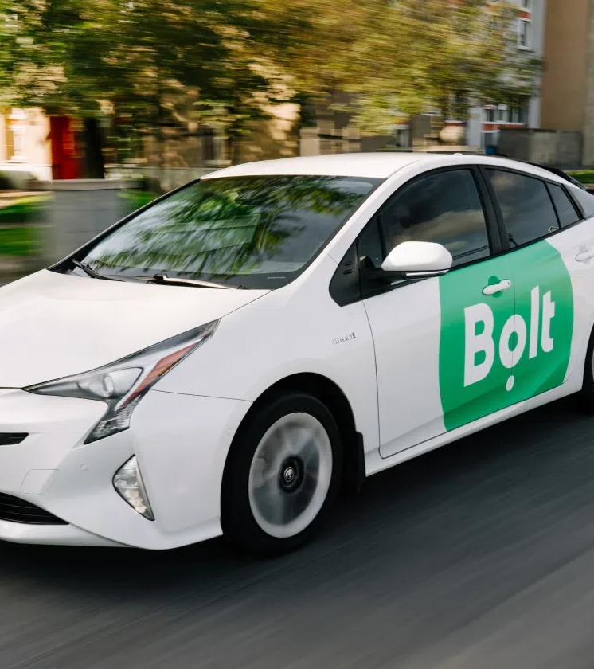
Homework Assignment for Data Analyst
Rafael Fagundes
Jul 2025

Slide 2

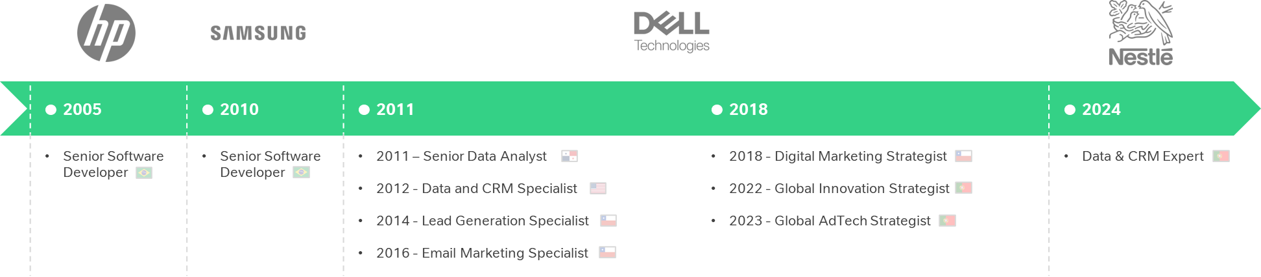
About me
Rafael Fagundes
Lisbon, Portugal
Data Analyst
linkedin.com/in/rsfagundes | rsfagundes.com
With 10+ years in data and marketing, I specialize in scalable, data-driven solutions using SQL and Python. I’m eager to support Bolt’s growth by empowering analysts and optimizing processes for impact.

Slide 3
Approach & Key Considerations
Part I: The main challenge for this task was ensuring the correct formulas were applied. Below are the formulas I used:
Additionally, I corrected a typo where "Commission" was misspelled as "Comission" in the DataFinance dataset. I also removed the % symbols from the Commission and Net Rate columns to allow proper referencing.
One point of uncertainty was whether the Commission values represented percentages or currency. Given how small the numbers were, I assumed they referred to percentages and calculated them as such.
To enable regional grouping, I created a "Country to Region Map" tab and used VLOOKUP to add a region_name column. Finally, I applied conditional formatting with color scales and highlighted negative numbers for better visualization.
Part II: Manually created the “Copy of Regional Review File” tab by replicating the structure from the “Regional Review File” tab and pre-filled it with the necessary data. Exported one file per region and removed irrelevant rows to keep only the data for each region. Due to Google Apps Script limitations, some formatting (colors, number formats) couldn’t be fully preserved.
Part III: Used Python to analyze the DataRides tab (exported as CSV). Calculated key metrics and visualized trends through charts. The short report follows a scorecard format, highlighting key metrics, main insights, and recommendations for clarity.
Metric | Definition | Formula
RIDES | Total number of rides | Sum of Rides
GMV | Gross Merchandise Value (Total value of orders) | Sum of GMV
ASP (PRICE) | Average Selling Price per Ride | GMV / RIDES
COMMISSION | Total commission earned (in %) | Average of Commission
NET RATE % | Profitability metric, typically Net Revenue / GMV | Average Net Rate %
EBITDA | Earnings Before Interest, Taxes, Depreciation, and Amortization | Sum of EBITDA
EBITDA % OF GMV | EBITDA margin relative to GMV | EBITDA / GMV

Slide 4
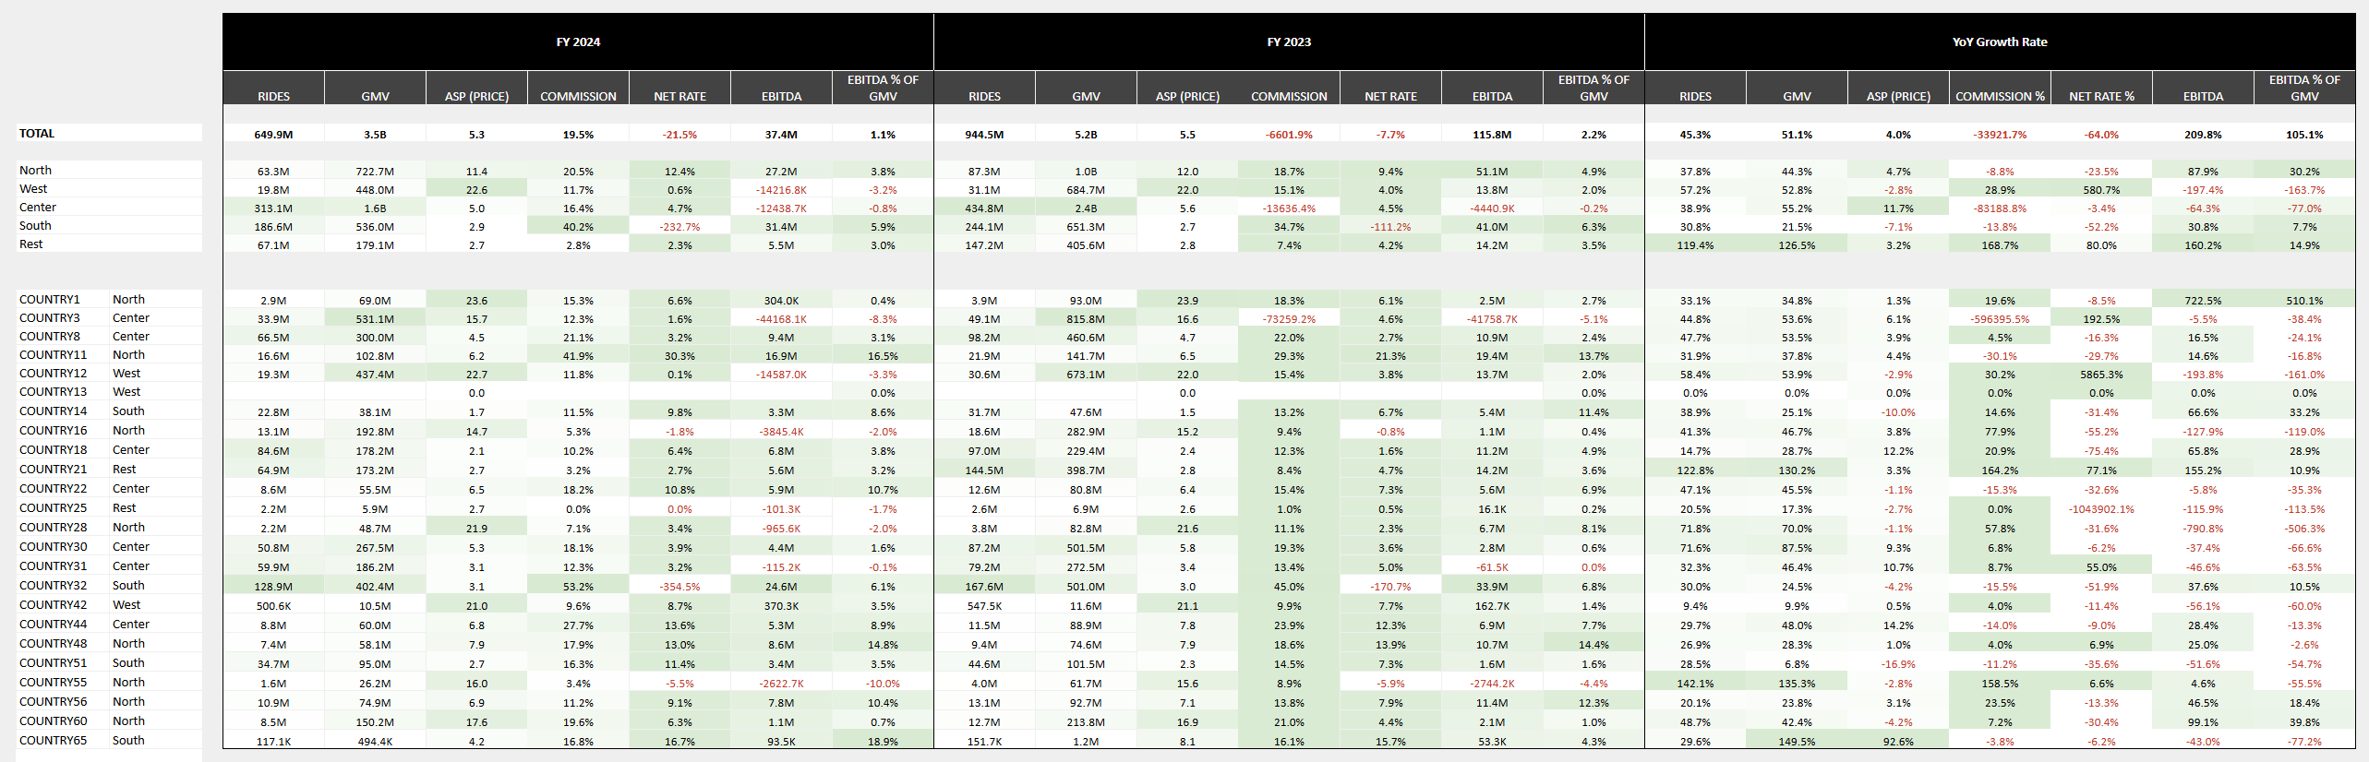
Part I: Spreadsheet Formulas & Formatting Assessment
The file used for this exercise is available here: https://docs.google.com/spreadsheets/d/15U8vTXwlxqysytAGqDIl2OE52IafyWpJhH5PfTem-iU/edit?usp=sharing

Slide 5
Part II: Apps Script Literacy
The regional files are available at the following links:
Regional file name | File URL | Folder URL
North | https://docs.google.com/spreadsheets/d/1_FZ4OWZsMLLuQWPjdC21Ag_kgyAi1gp6J9Uf5MXBHv8/edit?usp=drive_link | https://drive.google.com/drive/folders/17p6MVaKwG6HZUfI4iBVM6h_0iZ7elnxX?usp=sharing
West | https://docs.google.com/spreadsheets/d/1t9LNb-bgQGN-Mf5guP1MzT4TzYaJfJgdYzzmvyRYRWI/edit?usp=drive_link
Center | https://docs.google.com/spreadsheets/d/1uqUHuBU-PPftLPfqicBt0iISHf01l-WOjhPYxYWdP3o/edit?usp=drive_link
South | https://docs.google.com/spreadsheets/d/1RIa0aGn99A-vdCX_BkA4CX8_v0GADdjae6tyXpToR54/edit?usp=drive_link
Rest | https://docs.google.com/spreadsheets/d/1FVglUELLkgHoPVuP_32tBeunOzeGEyB6hXnDif5Um0s/edit?usp=sharing

Slide 6
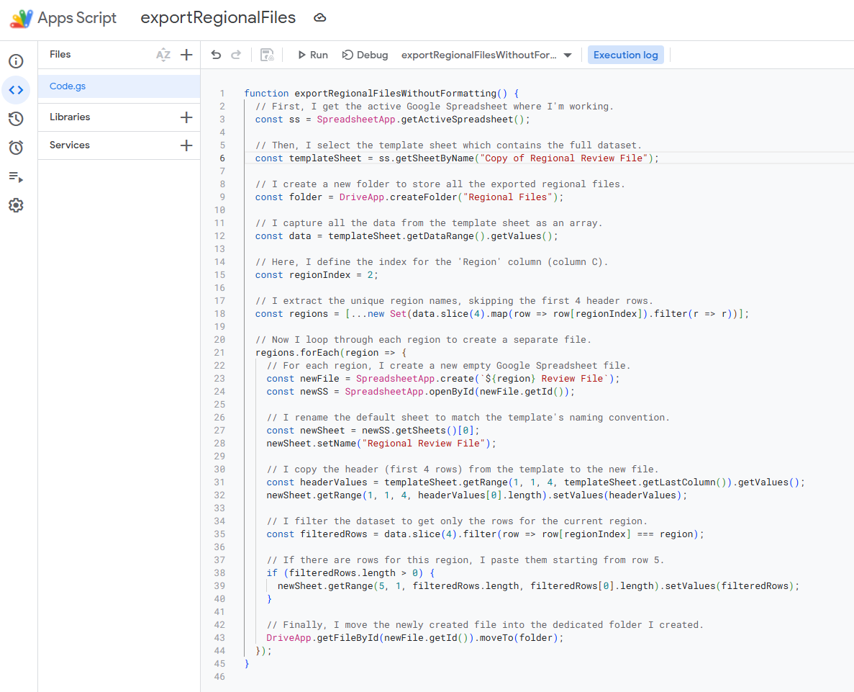
Part II: Apps Script Literacy
The Apps Script code is available here:

Slide 7
Part III: Market Analysis Report
Key Metrics
Total number of rides
72k
Avg. number of rides per day
10k
Avg. ride distance
8 km
Avg. ride duration
15 minutes
Avg. pickup distance
1.5 km
Avg. revenue per ride
€ 11
Total revenue generated
€ 796k
Avg. client rating
4.8 / 5
Key Insights
Most revenue concentrated during the morning peak (7-11am).
Saturday is the busiest day in volume.
Average ride is relatively short (8 km, 15 min).
Average ticket is ~€11.
Recommendations
Focus marketing on morning commuters.
Optimize driver supply for mornings and weekends.
Explore strategies to increase off-peak usage.
Refine pricing strategies during peak hours to maximize revenue.

